Slide 1
Homework 4: MININET/OPENDAYLIGHT INSTALLATION
CCN lab December 2016

Slide 2
Outline
Mininet
OpenDaylight
Add flow via REST API
Appendix
Reference

Slide 3
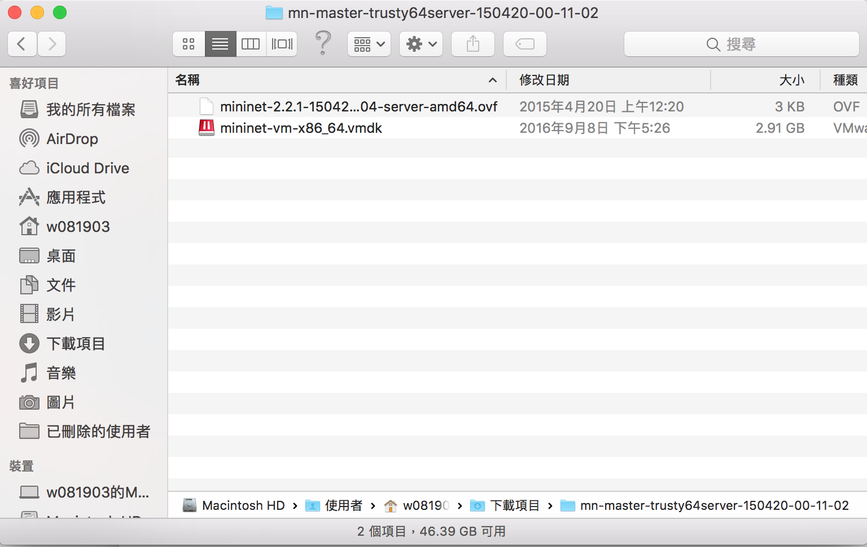
Mininet
Download virtual disk from https://github.com/mininet/mininet/wiki/Mininet-VM-Images

Slide 4
Mininet
Boot Mininet by Virtualbox, Vmware, Parallels Desktop

Slide 5
Virtualbox
Mininet image
Ubuntu
Interface 2
Interface 1
內部網路
NAT
Internet

Slide 6
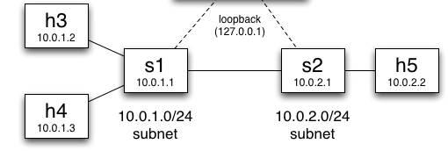
Virtualbox
Controller
內部網路
NAT
Internet

Slide 7
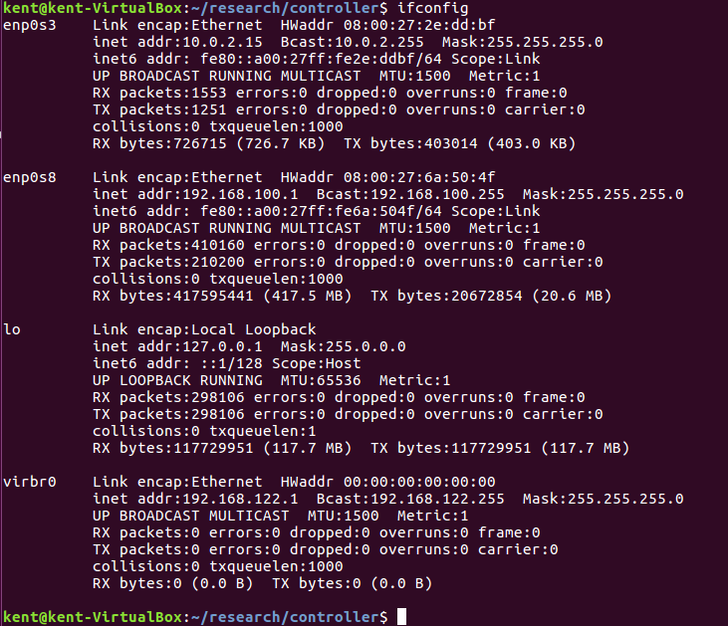
VirtualBox
Setup interfaces in Ubuntu
sudo dhclient enp0s3
sudo ifconfig enp0s8 192.168.100.1

Slide 8
VirtualBox
Setup interfaces in Mininet
sudo ifconfig eth0 192.168.100.2

Slide 9
Virtualbox
double-click on the .ovf file and import it
If you get errors importing the .ovf file, you can simply create a new VM of the appropriate type (e.g. Linux, Ubuntu 64-bit) and use the .vmdk file as the virtual hard disk for the new VM.
Select “settings,” and add an additional host-only network adapter that you can use log in to the VM image. Start the VM.

Slide 10
Vmware
Import the OVF file, then start the VM
VMware may ask you to install VMware tools on the VM - if it asks, decline

Slide 11
Parallels Desktop
Use Parallels Transporter to convert the .vmdk file to an .hdd image that Parallels can use, and then create a new VM using that .hdd image as its virtual drive. Start the VM.

Slide 12
Log in to VM
Account : mininet
Password : mininet

Slide 13
Log in via SSH
VMware : ssh -Y mininet@[mininet’s ip address]
Virtualbox : Users who have set up a host-only network on eth1 should use sudo dhclient eth1 and check it has an ip address
ssh -Y mininet@[mininet’s eth1 ip address]

Slide 14
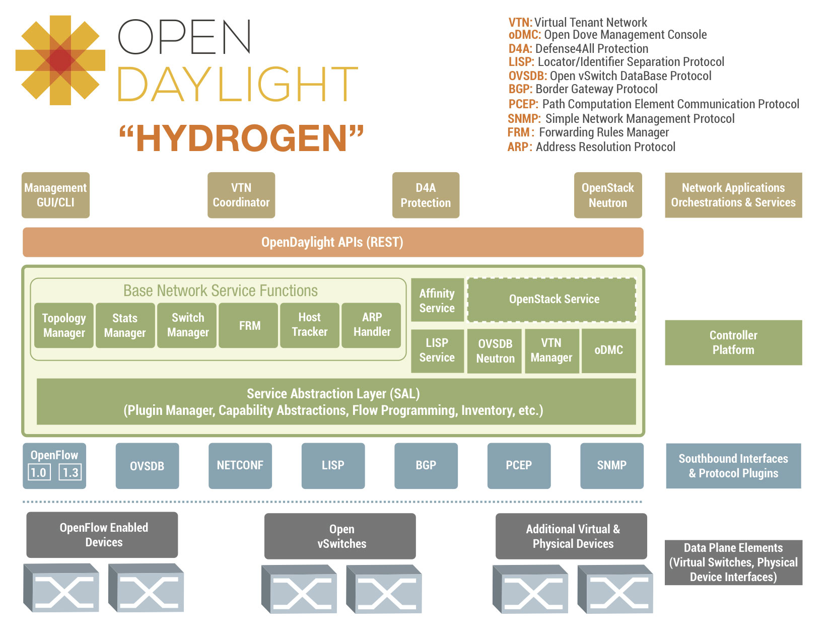
OpenDaylight

Slide 15
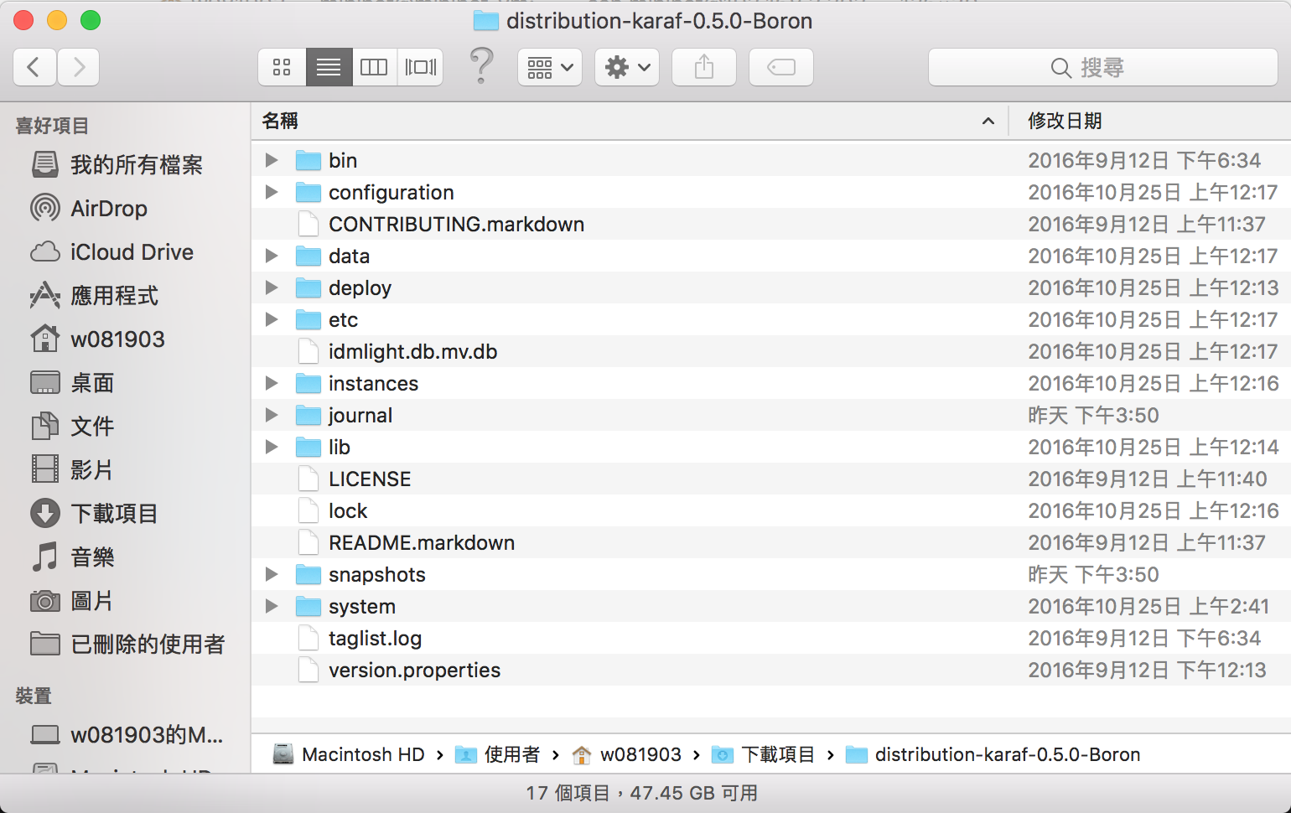
OpenDaylight
Download from https://nexus.opendaylight.org/content/repositories/opendaylight.release/org/opendaylight/integration/distribution-karaf/0.5.1-Boron-SR1/distribution-karaf-0.5.1-Boron-SR1.tar.gz

Slide 16
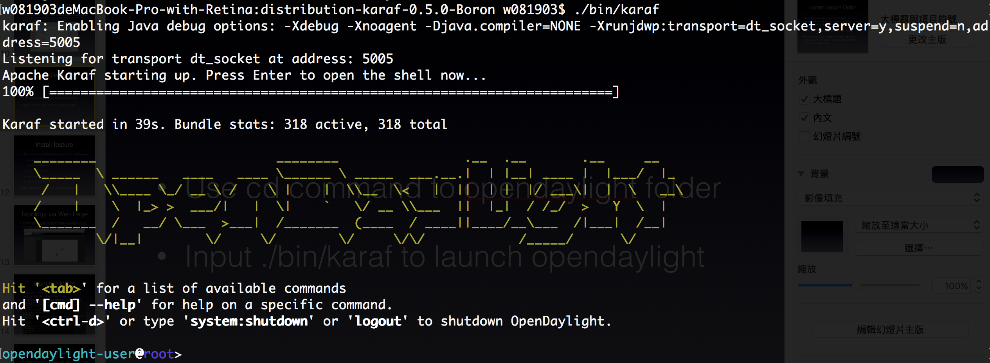
OpenDaylight
Use cd command to opendaylight folder
Input ./bin/karaf to launch opendaylight

Slide 17
Install feature
Use "feature install [feature name]" to install feature
feature:install odl-l2switch-switch-ui
feature:install odl-mdsal-all
feature:install odl-restconf
feature:install odl-dlux-all
Use feature:list -i to list all installed features

Slide 18
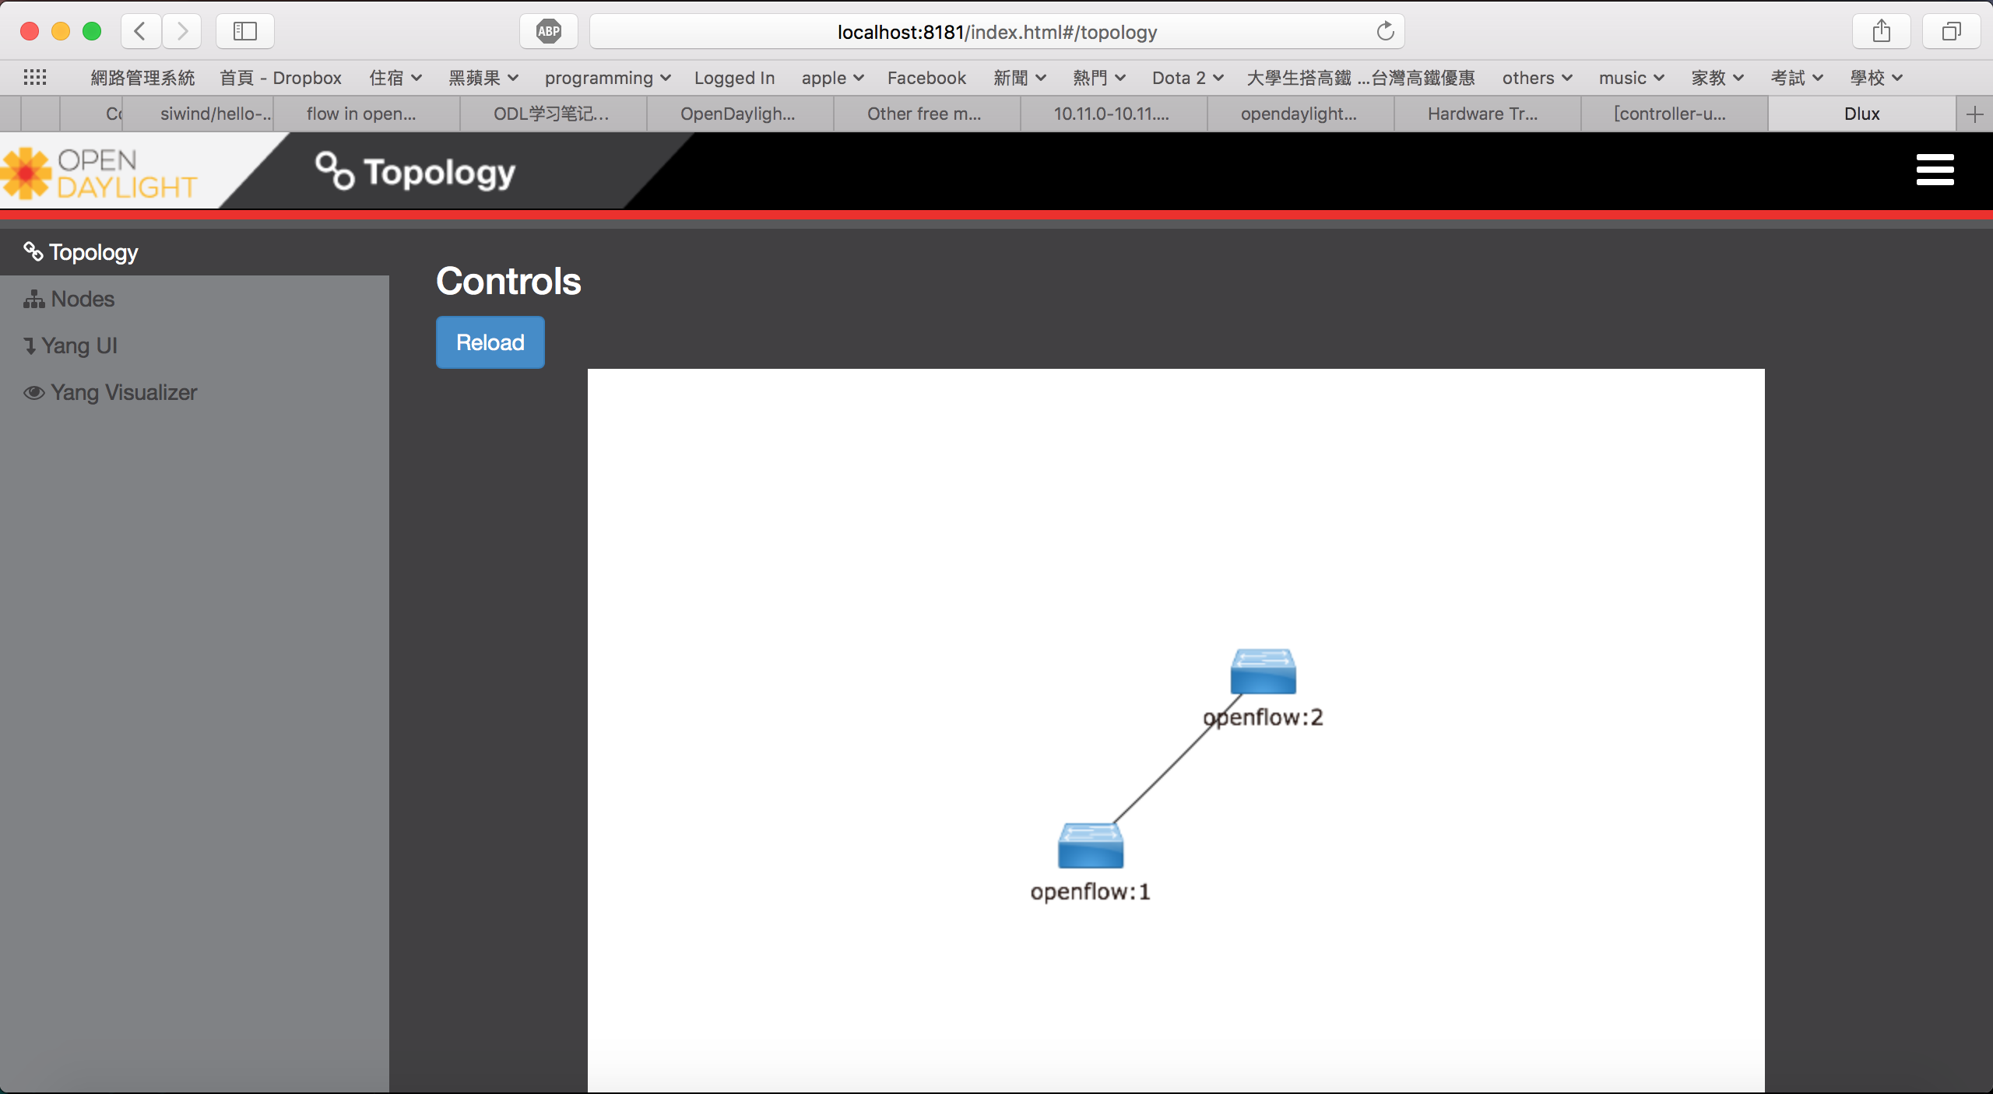
Topology via Web Page
Input http://localhost:8181/index.html#/topology on your browser.

Slide 19
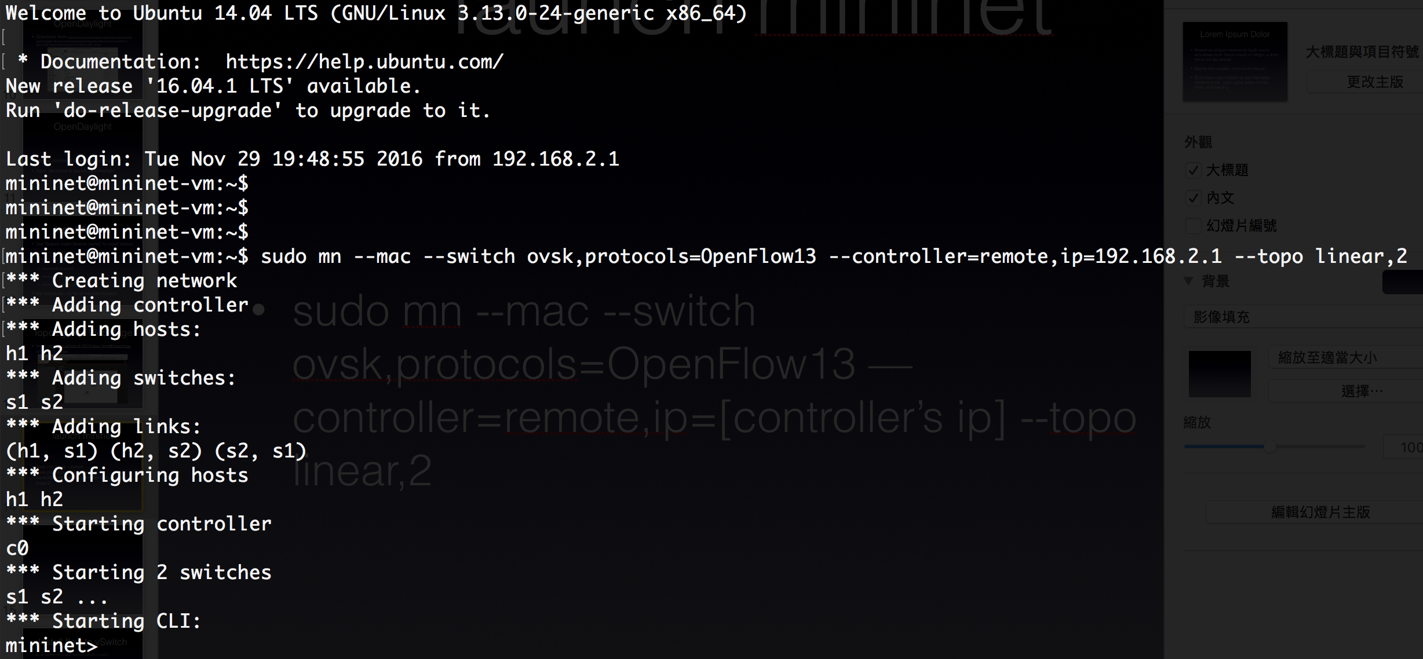
launch mininet
sudo mn --mac --switch ovsk,protocols=OpenFlow13 —controller=remote,ip=[controller’s ip] --topo linear,2
sudo mn --mac --switch ovsk,protocols=OpenFlow13
--controller=remote,ip=192.168.100.1
--custom ./mininet/custom/test.py --topo mytopo

Slide 20
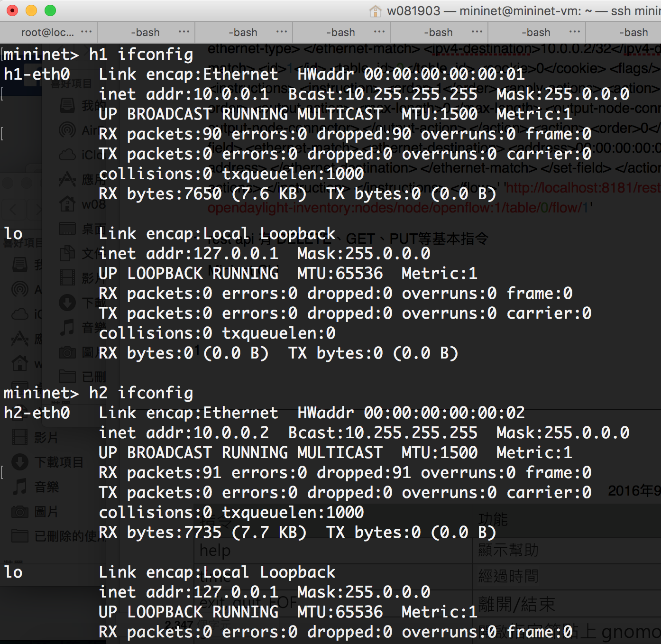
Mininet test
In mininet environment we can use h1 ifconfig to check what h1’s ip address it is.

Slide 21
Get Topology via Rest APIs
curl --user admin:admin -H 'Accept: application/xml' -H 'Content-type: application/xml' -X GET 'http://localhost:8181/restconf/operational/network-topology:network-topology/'

Slide 22
Install flow to vSwitch
We can use Rest API to install flow from controller to vswitch
curl --user admin:admin -H 'Accept: application/xml' -H 'Content-type: application/xml' -X PUT -d '<?xml version="1.0" encoding="UTF-8" standalone="no"?> <flow xmlns="urn:opendaylight:flow:inventory"> <priority>1</priority> <flow-name>Foo</flow-name> <match> <ethernet-match> <ethernet-type> <type>2048</type> </ethernet-type> </ethernet-match> <ipv4-destination>10.0.0.2/32</ipv4-destination> </match> <id>1</id> <table_id>0</table_id> <cookie>0</cookie> <flags/> <instructions> <instruction> <order>1</order> <apply-actions> <action> <order>1</order> <output-action> <max-length>0</max-length> <output-node-connector>3</output-node-connector> </output-action> </action></apply-actions> </instruction> </instructions> </flow>' 'http://localhost:8181/restconf/config/opendaylight-inventory:nodes/node/openflow:1/table/0/flow/1'
packet dest
Table ID
Flow ID
output port
Switch ID
Table ID
Flow ID

Slide 23
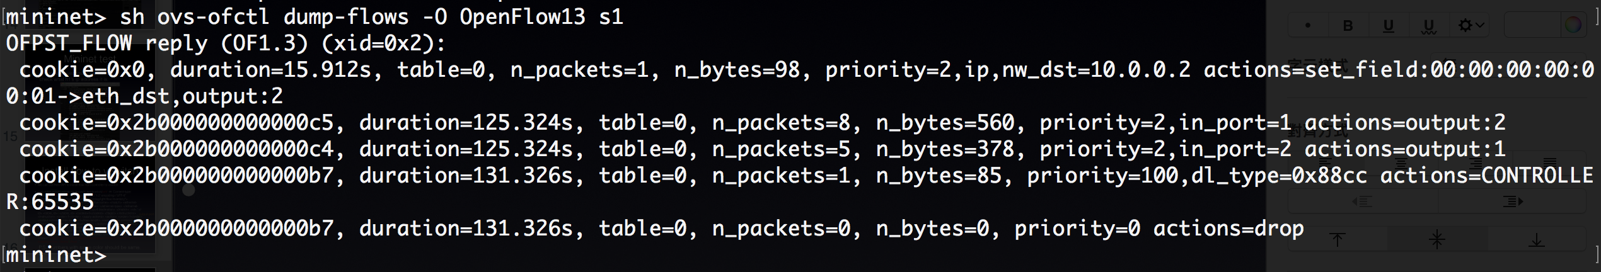
Check Flow
Use sh ovs-ofctl dump-flows -O OpenFlow13 s1
The flow which we add

Slide 24
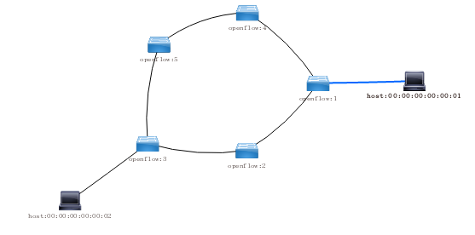
Test Topology
You should redirect traffic to this path instead of the shortest path
s4
h1
s5
s1
h2
s3
s2
Put test.py in to ~/mininet/custom/
sudo mn --mac --switch ovsk,protocols=OpenFlow13
--controller=remote,ip=192.168.100.1
--custom ./mininet/custom/test.py --topo mytopo

Slide 25
Test Traffic
Use iperf or ping
h1 ping h2
iperf

Slide 26
Check Flow
Use sh ovs-ofctl dump-flows -O OpenFlow13 s1

Slide 27
Demo
Contact your TAs
Jan. 3 ~ Jan. 6

Slide 28
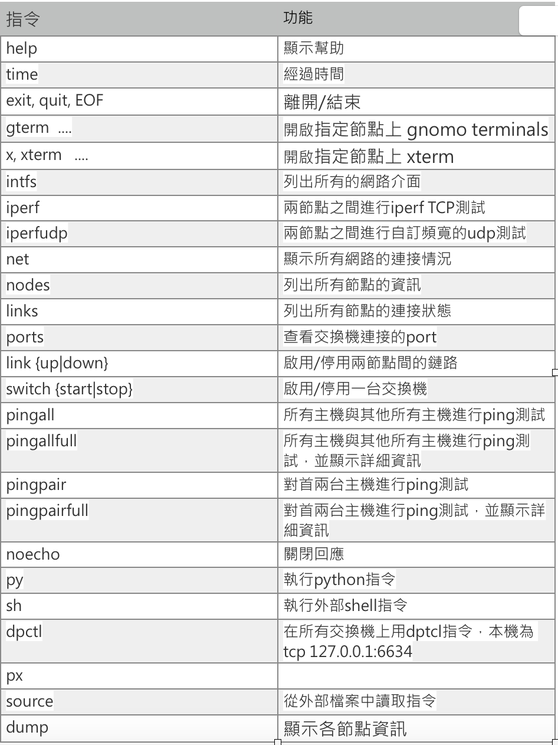
Appendix
Mininet CLI command

Slide 29
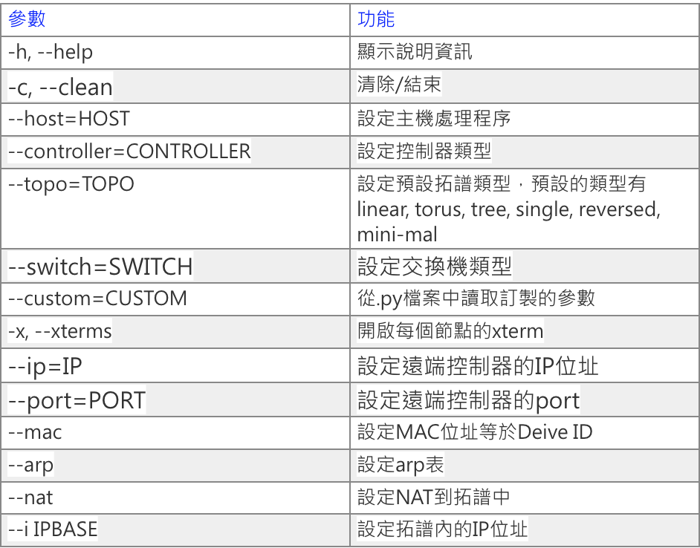
Appendix
the mn command’s
argument

Slide 30
reference
http://docs.opendaylight.org/en/stable-boron/getting-started-guide/installing_opendaylight.html
https://wiki.opendaylight.org/view/Editing_OpenDaylight_OpenFlow_Plugin:End_to_End_Flows:Example_Flows
http://mininet.org/download/

